Slide 1





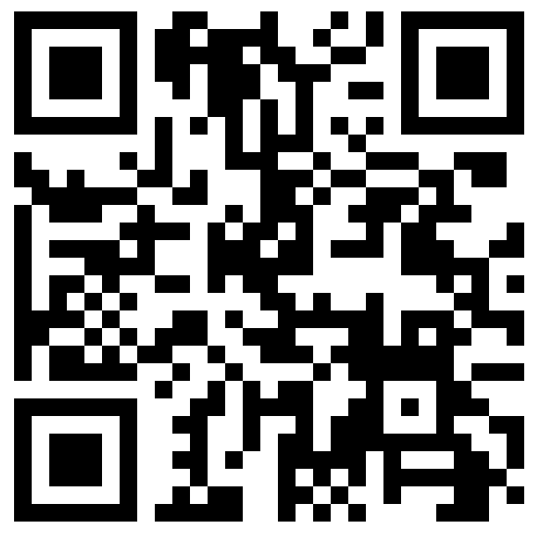

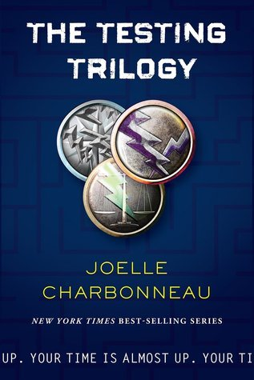
Are you between 16 and 25 years old?
Fan of speculative YA fiction? →
Your Voice Matters!
Survey (15 to 20 minutes) and
(optional!) follow-up interview
← For more information:
readingmentors.ugent.be
For questions, email: readingmentors@ugent.be

